Slide 1

Lab of Plotters | Group 1 Plotters Against Cancer
CU-VIRT-AI-PT-0602024-U-LOLC-MWTH | DATA ANALYSIS, PROJECT 1
Notes:
Our project name is “Plotters Against Cancer”

Slide 2






Lab of Plotters Team 1
Kala Sivasubramanian
Data Strategy Architect & Insights Alchemist… and Project Lead
Albert Hernandez
Data Ecosystem Innovator
& Analytics Luminary
The Team
Jordan Kesner
Metric Harmonization Engineer & Data Sculptor
Yifei Li
Big Data Illuminator & Synergistic Metrics Curator
Jonathan Schwartz
Empirical Data Scribe & Narrative Weaver
Frederik Tylim
Holistic Information Synthesis Illuminator
Notes:
Presenter: Frederik Tylim

Slide 3
The Question
How are cancer incidences – diagnosis and mortality from the disease – related to demographic and socioeconomic factors?
Race
Age
Education Level
Income Level
Insurance Coverage
Clinical Trials per Capita

Slide 4
Project Overview and Approach
Overview of the data collection, cleanup and exploration processes…
The approach our team took to achieve project goals…
This project performs an exploratory data analysis on a Kaggle dataset that includes an abundant set of socioeconomic and demographic factors across all US States. The analysis examines how these factors influence health outcomes.
Health Outcomes and Socioeconomic Factors (kaggle.com)
Data Cleanup
Combining Datasets (Average Household Size, Insurance and Clinical Trial Data)
Aggregating and Grouping Data (StateRank)
Dropping Rows with Null Values
Developing Correlations, Scatter Plots
Kala (Team Lead)
Expected to work individually at first but realized that could work more fluidly.
Shared results regularly with defined deliverables and goals for each session
Slack, Google Drive, GitHub Repository
Assigned specific factors for each coder
ReadMe, Analysis
PowerPoint, Research
Notes:
Add Detail

Slide 5
Data Analysis
Notes:
Our project name is “Plotters Against Cancer”

Slide 6

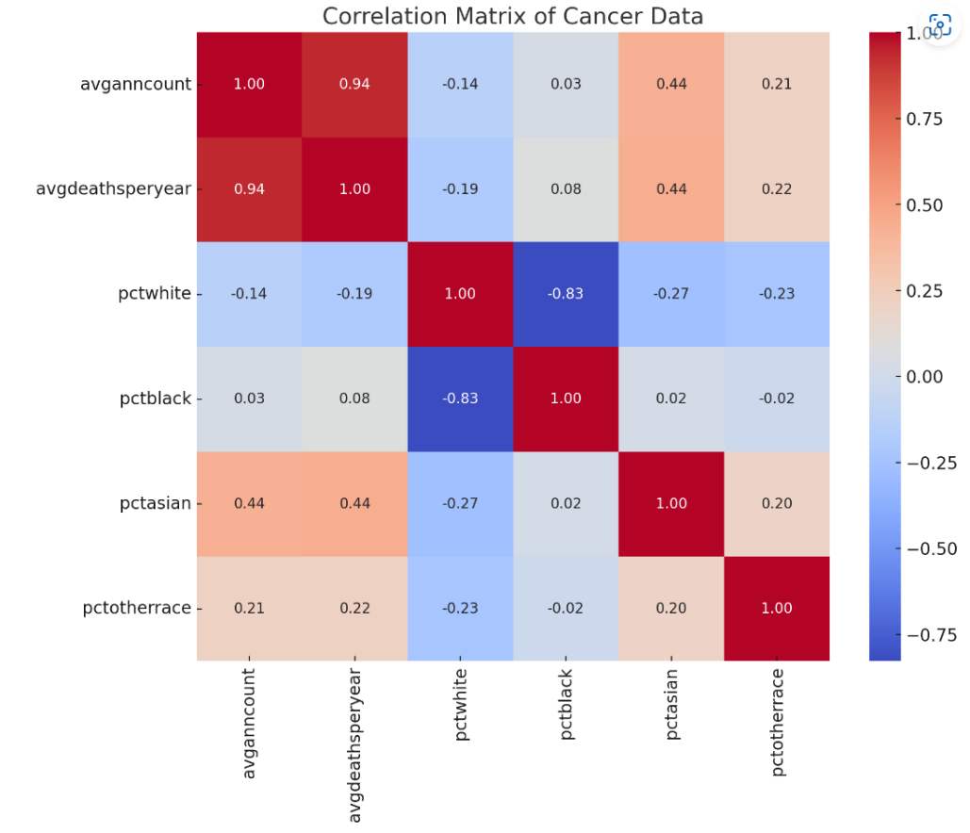
What correlations, if any, exist between incidence of cancer and race of the people affected?
ALBERT
Question
Slight tendency for states with higher percentages of white populations to have lower cancer counts (-0.14)
Weak negative correlation between cancer incidence and percent of white population (-0.14)
Extremely weak positive correlation between average annual cancer count and percentage of population that is Black, indicating no meaningful relationship (0.03)
Asian has moderate positive correlation, resulting in a fairly consistent relationship in the data (0.44)
Correlation between average cancer count and “Other” races is not meaningful. (0.21)
Analysis
Conclusion:
1. Other factors are likely to have more significant impact on cancer rates than race alone.
2. Race also a difficult characteristic to manage through based on definitions and relative populations sizes. (Hispanics may be included in data as “White” or “Other”. Wide diversity among Asian population.)
Conclusions
Notes:
Presenter: Albert

Slide 7
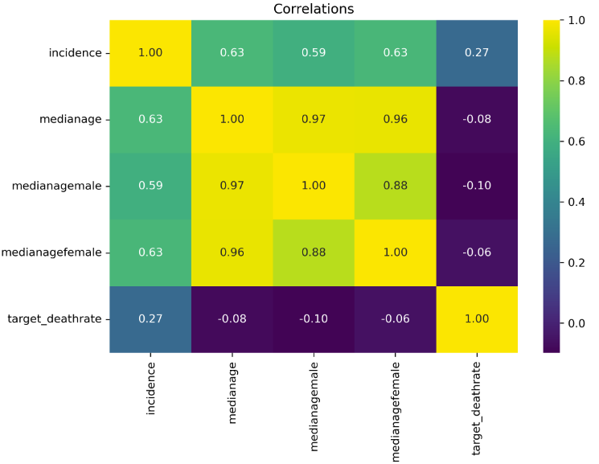
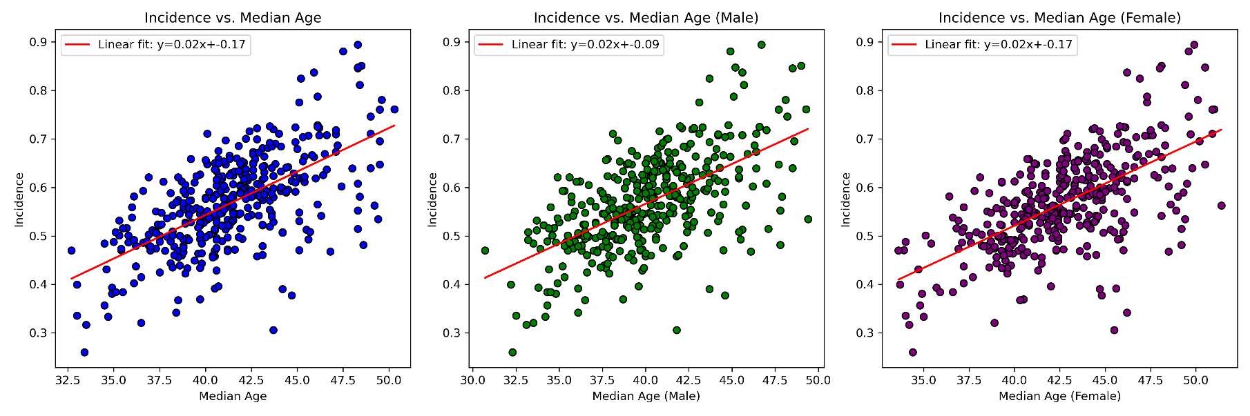
What relationship(s) exist between incidence rate of cancers and the median age of a given population within a geographic region in the United States?
Jordan
Question
Expectation: Moderate to strong positive correlation between median age and incidence of cancer within a given population, regardless of gender.
Strong correlation of 0.63 between incidence and median age- Strong correlation of 0.59 between incidence and median male age- Strong correlation of 0.62 between incidence and median female age
Analysis
Conclusion(s):
As expected, there was a moderate to strong positive correlation between the median age of the population and the incidence of cancer. Interestingly, this correlation is slightly stronger among female populations. This could be explained as random noise or could have a biological connection in differences between cancers that predominantly affect one gender or the other, and which are more-or-less dependent on age of the affected individuals. (Age/Types)
Conclusions
Notes:
Presenter: Jordan. UPDATE “HEATMAP EXAMPLE”

Slide 8
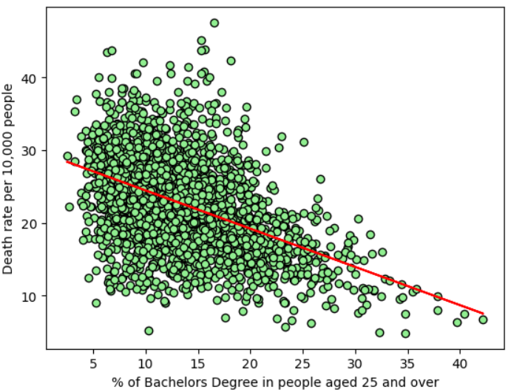
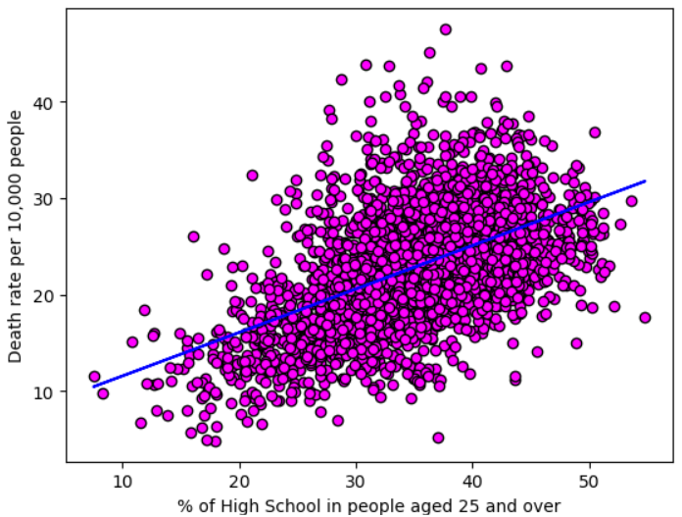
Is There a Relationship Between Cancer Incidence and/or Death Rates with Education Level?
KALA
Question
The columns "Some College 18-24 %", "Bachelor’s Degree 18-24 %" and "Bachelor’s Degree 25 and Over %" all show negative correlations to cancer incidence rates, though they are extremely weak correlations.
The average number of deaths has a moderate negative correlation (-0.448336) with "Bachelor’s Degree 25 and Over %" and a moderate positive correlation (0.487745) with "High School 25 and Over %".
Analysis
Populations that have a greater percentage of people over 25 with a Bachelor’s Degree have lower percentage of cancer deaths. The reverse is also moderately true. Populations that have a greater percentage of people over 25 with only a high school degree experience a higher percentage of cancer deaths.
Conclusions
Notes:
Presenter: Kala

Slide 9
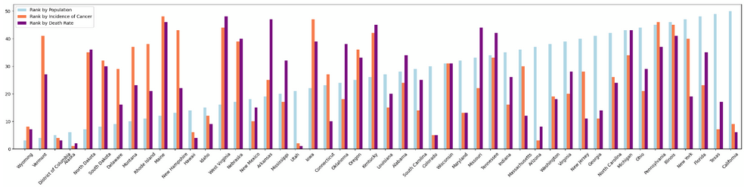
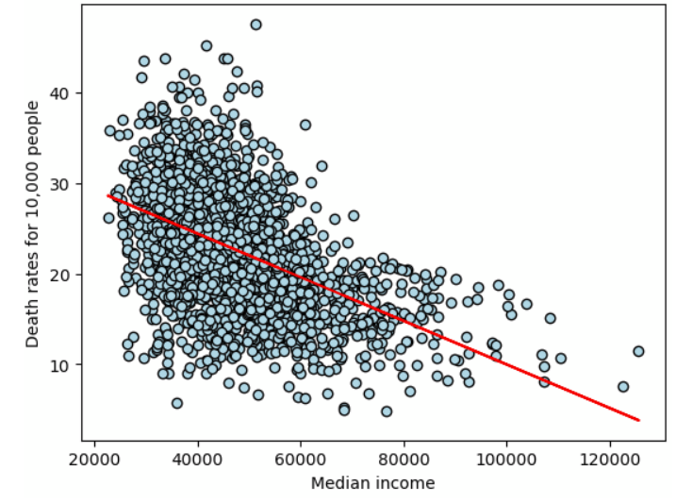
Correlations of Cancer Incidence with Median Income and State?
KALA
Populations with higher median incomes have lower death rates due to cancer.
Notes:
California has the largest population but a low rank of 9 for cancer incidence and 6 for death rates.
Vermont has a small population (rank 4), but ranks high for cancer incidence and death rates (41 and 27 respectively).
Conclusions
Notes:
Presenter: Kala

Slide 10
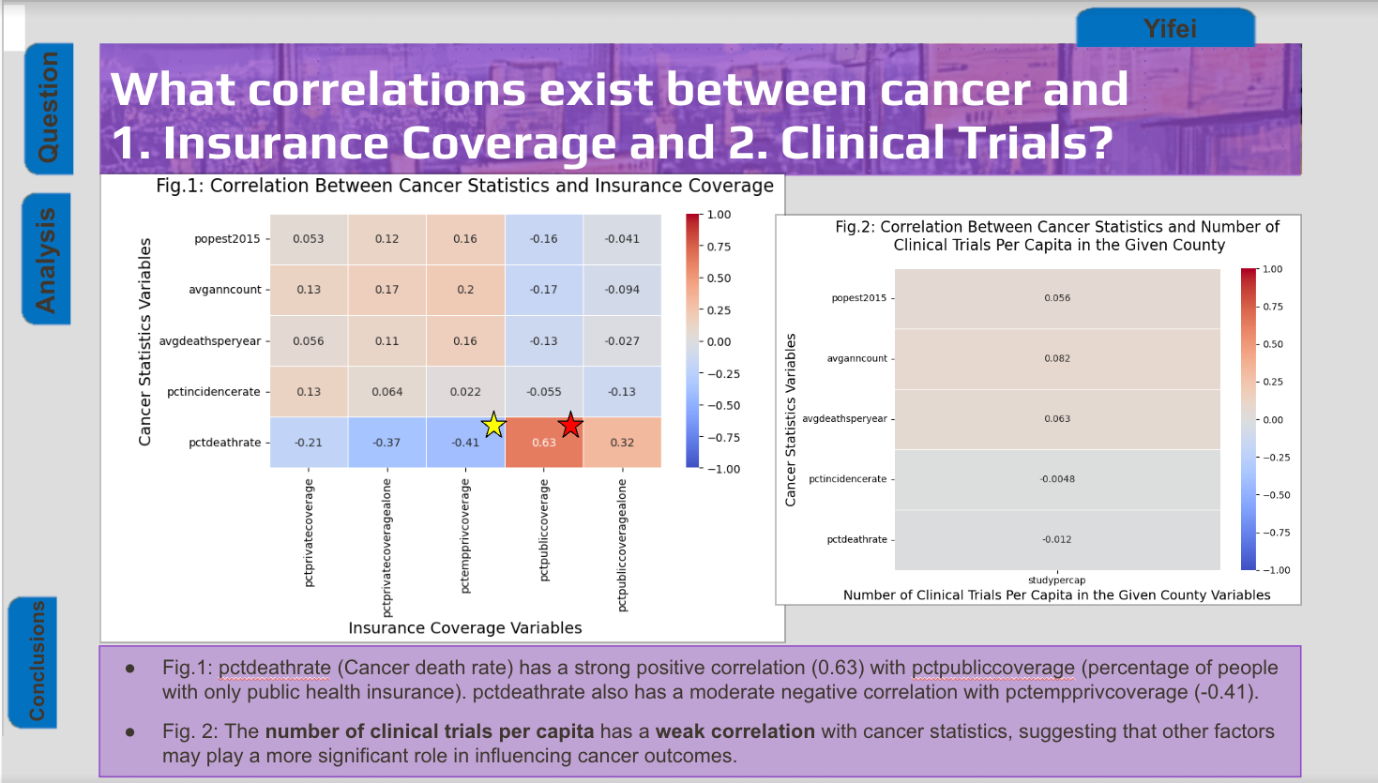

Slide 11
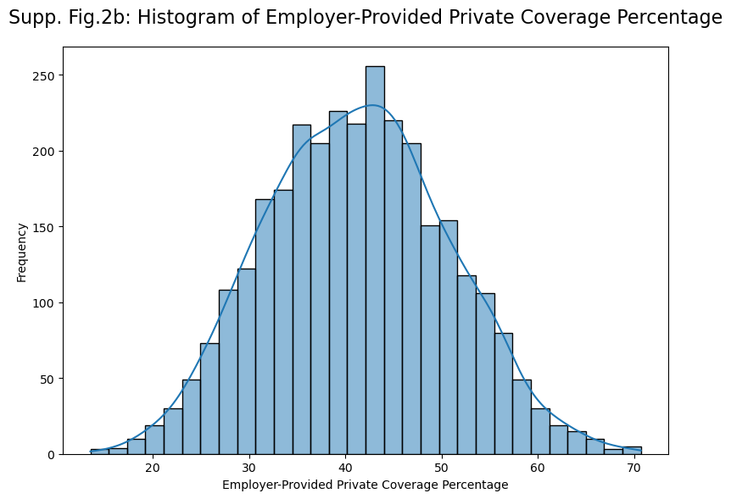
Project Conclusions
Future Research Opportunities
The strongest correlation to cancer outcomes was economic level
Cross-Disease Comparisons
Device-Level, Individualized Data
Data Analysis
Added Rigor
Better Techniques to Make Predictions
Data Stability (Old Dataset)
Notes:
Presenter: Jonathan

Slide 12
Thank you.
Notes:
Our project name is “Plotters Against Cancer”

Slide 13
Questions, Comments… Concerns?
Notes:
Our project name is “Plotters Against Cancer”

Slide 14
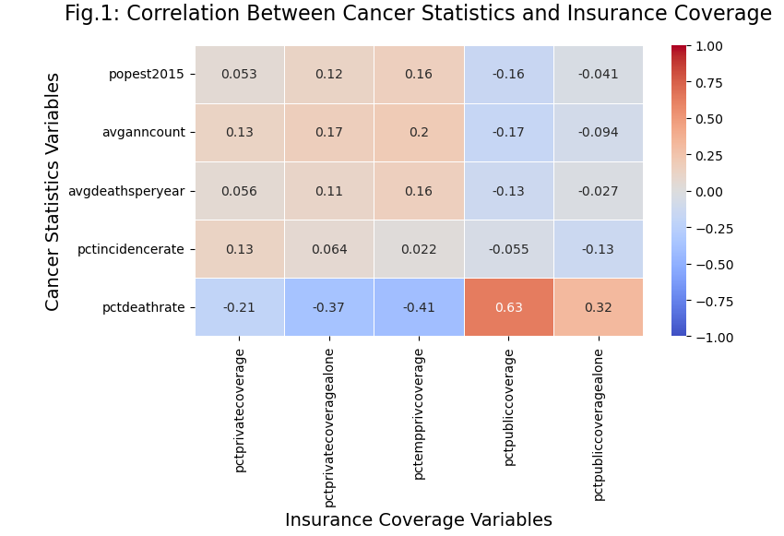
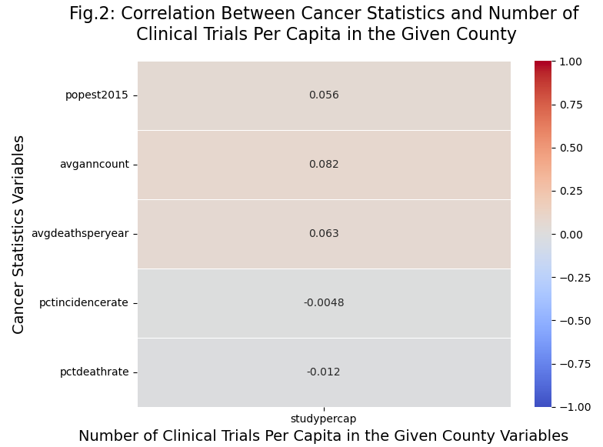
What correlations exist between cancer and 1. Insurance Coverage and 2. Clinical Trials?
Yifei
Question
Analysis
pctdeathrate (Cancer death rate) has a strong positive correlation (0.63) with pctpubliccoveragealone (percentage of people with only public health insurance). This suggests that counties with higher public health insurance coverage alone might have higher cancer death rates.
The number of clinical trials per capita has a weak correlation with cancer statistics, suggesting that other factors may play a more significant role in influencing cancer outcomes.
Conclusions
Notes:
Presenter: Yifei

